Slide 1
Branches
Module 3

Slide 2
Topics
The if Statement
The if-else Statement
Nested if Statements
The if-else-if Statement
Logical Operators
Comparing String Objects
The Conditional Operator
The switch Statement

Slide 3
The if Statement
The if statement decides whether a section of code executes or not.
The if statement uses a boolean to decide whether the next statement or block of statements executes.
if (boolean expression is true)
execute next statement.

Slide 4
Flowcharts
If statements can be modeled as a flow chart.
if (coldOutside)
wearCoat();
Is it cold
outside?
Yes
Wear a coat.

Slide 5
Flowcharts (cont’d)
A block if statement may be modeled as:
if (coldOutside) {
wearCoat();
wearHat();
wearGloves();
}
Is it cold
outside?
Yes
Wear a coat.
Wear a hat.
Wear gloves.
Note the use of curly
braces to block several
statements together.

Slide 6
Relational Operators
In most cases, the boolean expression, used by the if statement, uses relational operators.
Relational Operator | Meaning
> | is greater than
< | is less than
>= | is greater than or equal to
<= | is less than or equal to
== | is equal to
!= | is not equal to

Slide 7
Boolean Expressions
A boolean expression is any variable or calculation that results in a true or false condition.
Expression | Meaning
x > y | Is x greater than y?
x < y | Is x less than y?
x >= y | Is x greater than or equal to y?
x <= y | Is x less than or equal to y.
x == y | Is x equal to y?
x != y | Is x not equal to y?

Slide 8
if Statements and Boolean Expressions
if (x > y)
System.out.println("X is greater than Y");
if(x == y)
System.out.println("X is equal to Y");
if(x != y)
{
System.out.println("X is not equal to Y");
x = y;
System.out.println("However, now it is.");
}

Slide 9
Programming Style and if Statements (cont’d)
Rules of thumb:
The conditionally executed statement should be on the line after the if condition.
The conditionally executed statement should be indented one level from the if condition.
If an if statement does not have the block curly braces, it is ended by the first semicolon encountered after the if condition.
if (expression)
statement;
No semicolon here. Semicolon ends statement here.

Slide 10

Having Multiple Conditionally-Executed Statements
Conditionally executed statements can be grouped into a block by using curly braces {} to enclose them.
If curly braces are used to group conditionally executed statements, the if statement is ended by the closing curly brace.
if (expression)
{
statement1;
statement2;
}
Curly brace ends the statement.

Slide 11
Having Multiple Conditionally-Executed Statements (cont’d)
Remember that when the curly braces are not used, then only the next statement after the if condition will be executed conditionally.
if (expression)
statement1;
statement2;
statement3;
Only this statement is conditionally executed.

Slide 12
Comparing Characters
Characters can be tested using the relational operators.
Characters are stored in the computer using the Unicode character format.
Unicode is stored as a sixteen (16) bit number.
Characters are ordinal, meaning they have an order in the Unicode character set.
Since characters are ordinal, they can be compared to each other.
char c = ′A′;
if(c < ′Z′)
System.out.println("A is less than Z");

Slide 13
if-else Statements
The if-else statement adds the ability to conditionally execute code when the if condition is false.
if (expression)
statementOrBlockIfTrue;
else
statementOrBlockIfFalse;

Slide 14
if-else Statement Flowcharts
No
Yes
Is it cold
outside?
Wear shorts.
Wear a coat.

Slide 15
Nested if Statements
If an if statement appears inside another if statement (single or block) it is called a nested if statement.
The nested if is executed only if the outer if statement results in a true condition.
if ( x > 10 ) { if ( y < 20 ) { System.out.println(“both if statements are true”); } else { System.out.println(“outer if is true and inner if is false”); } } else { System.out.println(“outer if is false”); }

Slide 16
Nested if Statement Flowcharts
No
Yes
Is it cold
outside?
Wear shorts.
No
Is it
snowing?
Yes
Wear a jacket.
Wear a parka.

Slide 17
if-else Matching
if (employed == ′y′)
{
if (recentGrad == ′y′)
{
System.out.println("You qualify for the " +
"special interest rate.");
}
else
{
System.out.println("You must be a recent " +
"college graduate to qualify.");
}
}
else
{
System.out.println("You must be employed to qualify.");
}

Slide 18
if-else-if Statements
if (expression)
statement or block
else if (expression)
statement or block
// Put as many else ifs as needed here
else
statement or block
Care must be used since else statements match up with the immediately preceding unmatched if statement.

Slide 19
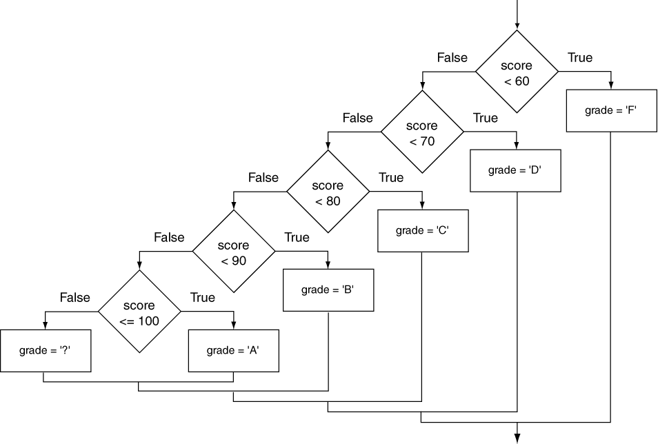
if-else-if Flowchart

Slide 20
Logical Operators
Operator | Meaning | Effect
&& | AND | Connects two boolean expressions into one. Both expressions must be true for the overall expression to be true.
|| | OR | Connects two boolean expressions into one. One or both expressions must be true for the overall expression to be true. It is only necessary for one to be true, and it does not matter which one.
! | NOT | The ! operator reverses the truth of a boolean expression. If it is applied to an expression that is true, the operator returns false. If it is applied to an expression that is false, the operator returns true.

Slide 21
The && Operator
The logical AND operator (&&) takes two operands that must both be boolean expressions.
The resulting combined expression is true if (and only if) both operands are true.
Expression 1 | Expression 2 | Expression1 && Expression2
true | false | false
false | true | false
false | false | false
true | true | true

Slide 22
The || Operator
The logical OR operator (||) takes two operands that must both be boolean expressions.
The resulting combined expression is false if (and only if) both operands are false.
Expression 1 | Expression 2 | Expression1 || Expression2
true | false | true
false | true | true
false | false | false
true | true | true

Slide 23
The ! Operator
The ! operator performs a logical NOT operation.
If an expression is true, !expression will be false.
if (!(temperature > 100))
System.out.println("Below the maximum temperature.");
If temperature > 100 evaluates to false, then the output statement will be run.
Expression 1 | !Expression1
true | false
false | true

Slide 24
Short Circuiting
Logical AND and logical OR operations perform short-circuit evaluation of expressions.
Logical AND will evaluate to false as soon as it sees that one of its operands is a false expression.
Logical OR will evaluate to true as soon as it sees that one of its operands is a true expression.
if (x > 10 && x < 20)
if (x > 10 || x < 20)

Slide 25
Order of Precedence
The ! operator has a higher order of precedence than the && and || operators.
The && and || operators have a lower precedence than relational operators like < and >.
Parenthesis can be used to force the precedence to be changed.
if (!x && y > 0 || z == 100)
if (z == 100 && !x || y > 0)

Slide 26
Order of Precedence
Order of Precedence | Operators | Description
1 | (unary negation) ! | Unary negation, logical NOT
2 | * / % | Multiplication, Division, Modulus
3 | + - | Addition, Subtraction
4 | < > <= >= | Less-than, Greater-than, Less-than or equal to, Greater-than or equal to
5 | == != | Is equal to, Is not equal to
6 | && | Logical AND
7 | || | Logical NOT
8 | = += -= *= /= %= | Assignment and combined assignment operators.

Slide 27
Comparing String Objects
In most cases, you cannot use the relational operators to compare two String objects.
Reference variables contain the address of the object they represent.
Unless the references point to the same object, the relational operators will not return true.
String s1 = “hello”; String s2 = “Hello”;
if (s1 == s2) //NO!
if (s1.equals(s2)) //Yes!

Slide 28
The Conditional Operator
The conditional operator is a ternary (three operand) operator.
You can use the conditional operator to write a simple statement that works like an if-else statement.
The format of the operators is:
expression1 ? expression2 : expression3
The conditional operator can also return a value.

Slide 29
The Conditional Operator
The conditional operator can be used as a shortened if-else statement:
x > y ? z = 10 : z = 5;
This line is functionally equivalent to:
if(x > y)
z = 10;
else
z = 5;

Slide 30
The Conditional Operator
Many times, the conditional operator is used to supply a value.
number = x > y ? 10 : 5;
This is functionally equivalent to:
if(x > y)
number = 10;
else
number = 5;

Slide 31
The switch Statement
The if-else statement allows you to make true / false branches.
The switch statement allows you to use an ordinal value to determine how a program will branch.
The switch statement can evaluate a char, byte, short, int, or string value and make decisions based on the value.

Slide 32
The switch Statement
The switch statement takes the form:
switch (number)
{
case 1:
// place one or more statements here
break;
case 2:
// place one or more statements here
break;
default:
// place one or more statements here
}

Slide 33
Case statements
The switch statement takes the form:
switch (letter)
{
case ‘a’:
case ‘e’:
case ‘i’:
case ‘o’:
case ‘u’: vowel = true; break; }

Slide 34
End of Module 3

